Slide 1
ServiceNow Assessments
Prepared by Rose Harris

Slide 2
Survey/Assessment Topics
Importance of Customer Feedback
Assessment Reporting /Scorecards
Assignment Group Manager Responsibilities

Slide 3
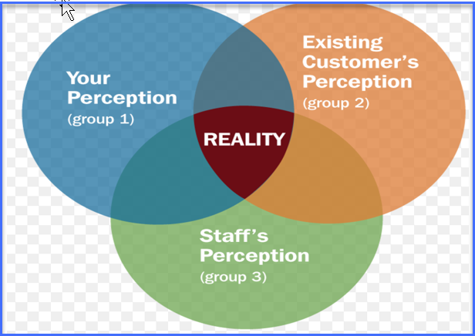
Why is it Important to Gather Feedback
Notes:
Could be meeting your SLA but still have dissatisfied customers. This tool will give you the opportunity to address perception / set expectations of your customers reality

Slide 4
Ways to Gather Customer Feedback
Service Desk Calls | X
Meet with Customer | X
Phone Call/ Walkin/Email | X
Customer Satisfaction Assessment at Incident Resolution | Low Cost Leader Immediate Feedback Comparative Reporting
Notes:
Although Assessments was one of my goals over the last year, It was certainly a coordinated team effort to deliver this new functionality to you. I would be remiss not to recognized everyone's hard work.
Incident Managers (IM) – Prioritized the Backlog item to replace the Legacy Survey with the New Enhanced Survey Management Tool. They also championed their tool requirements and worked to gather consensus across Emory's differing divisions and schools.
Mark Kawasaki and Missie Martin – Worked to build a report view which afforded us the comparative reporting you will see in the presentation.
Al Shelton – The Lead Developer worked tirelessly to meet the many challenges of coding all of our requirements. Last I check , he was at 300 lines of code which had to be duplicated in multiple lower instance before we were able to sign off on the final Request Change.

Slide 5
Survey Details
 | Assessments
Survey Structure | Communications contain the term “Survey” (Tool is Assessment) Questions are Optional Measurable Likert Scale 8 Questions total of which 6 are scored Incident Module only for Record type Incident and Request No Service Request Module Assessments (May Change in the near future)
Survey Parameters | Customer must log into ServiceNow There is a 1 to 1 relationship between Assessment and a Ticket Assessments Closed complete after 48 hours Menu option provides the capability to save answers for incomplete Assessments
Notifications | Resolved Survey Invitation New! Negative Feedback
Reporting | Scorecards (Comparative Reporting) Scoring Open to all ITIL users

Slide 6
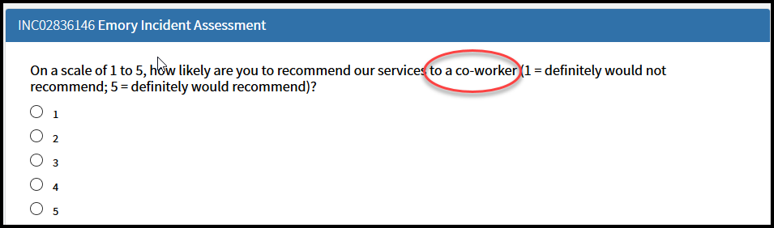
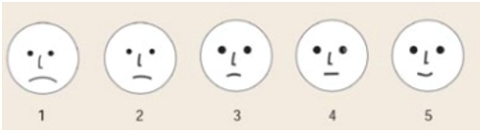
One Assessment Answer offers Numeric Value selections

Slide 7
Balance of Assessment Question are on a Likert Scale
“Scorecard” type reports use the Likert Scale with the following values:
(1) Very Poor
(2) Poor
Neutral
Good
(5) Excellent
The Likert-type scale is the most widely used approach to scaling responses

Slide 8
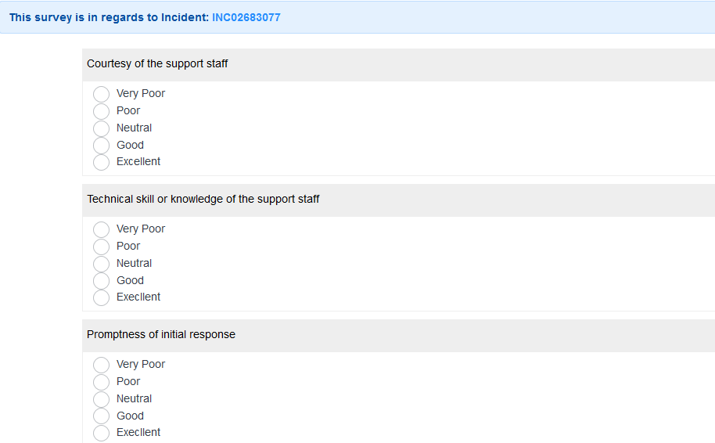
Likert Scale Assessment Question Sample

Slide 9
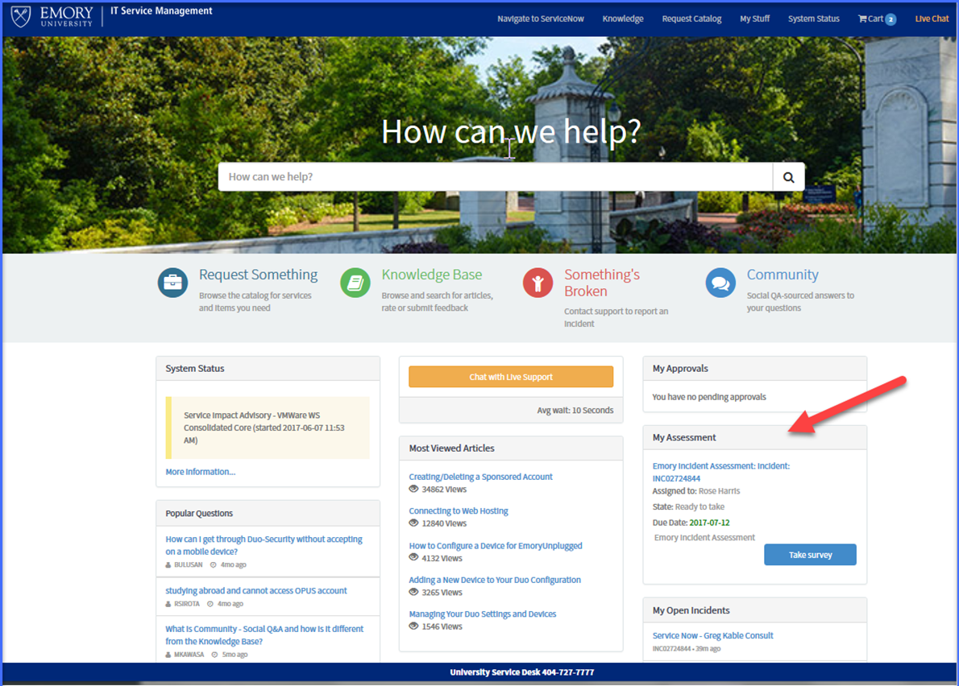
End User Assessment Options

Slide 10
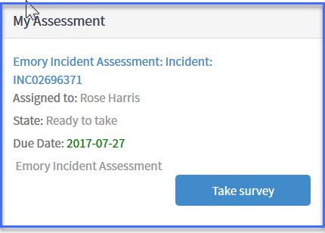
End User - Self-Service Assessment Repository

Slide 11
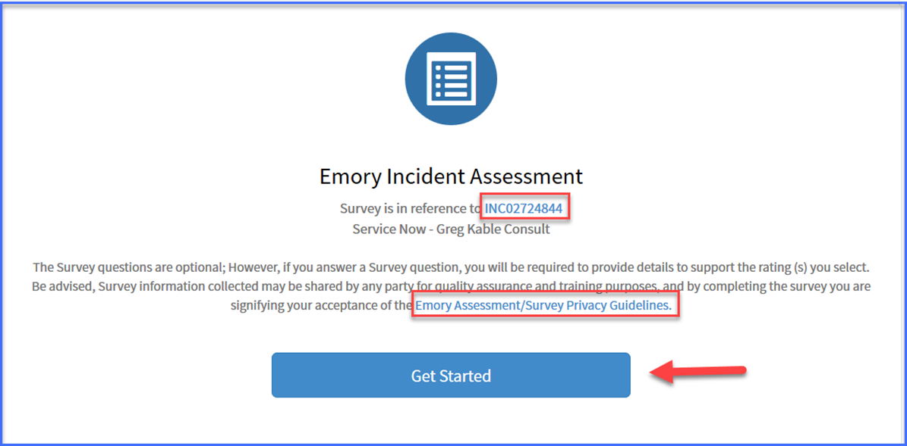
Get Started Page

Slide 12
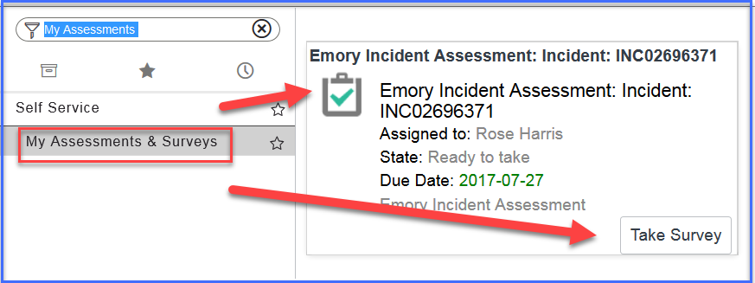
ITIL User - Assessment Repository

Slide 13
Resolved Notification
Subject: RESOLVED: Incident NC02824675 [QUOTED] Order - (6) Corded Apple Mouse has been resolved
Dear Sharon P,
Your Incident INC02824675 has been resolved by LITS: Client Services- Tier 2 with the following resolution notes.
Resolution notes: The issue with the batteries have been removed, I am closing this Incident,
Detailed description: Batteries for Wireless mouse die too quickly. It would be more cost effective to purchase (6) corded mice than to continue purchasing batteries.
Important Note:
You have (5) days to verify your Incident has been resolved to your satisfaction. If you are NOT satisfied with the resolution of your Incident click here to add additional work details and reopen this Incident.
After (5) days, you will not be able to reopen this Incident. However, you can access the Something Broken option to create a new ticket or contact the University Service Desk at 404. 727.7777 for further assistance.
Sincerely,
Incident Management

Slide 14
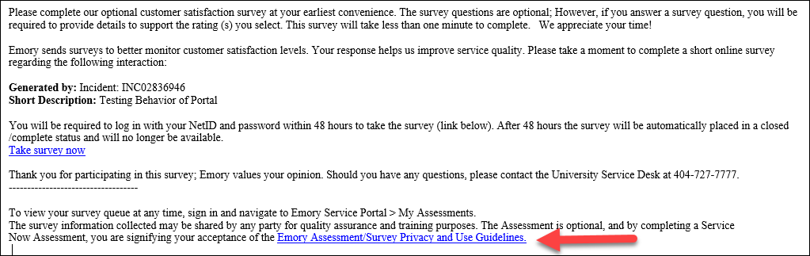
Customer Survey Invitation
The Assessment contains terms of use and escalation procedures for misuse of the tool including inappropriate language.

Slide 15
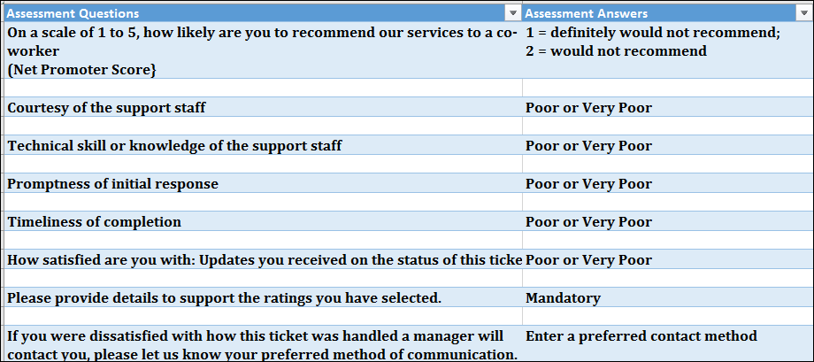
Negative Feedback Notification

Slide 16

Assessment Reporting Basics
Report table name:
New Assessment Details /Updated in real time
Reports will pull your group(s) data dynamically
Reports will pull both Incident and Request Record types into the same report
https://emory.service-now.com/kb_view.do?sysparm_article=KB05254
Report editing capabilities if you are not a member of the group(s) you manage
Report filter can be edited to report on different reporting fields and ranges (Use INSERT)

Slide 17
Analyst and Assignment Group Scorecards
Assessments: My Groups Avg Score by Analyst
Assessments: My Groups Avg Score by Assignment Group

Slide 18
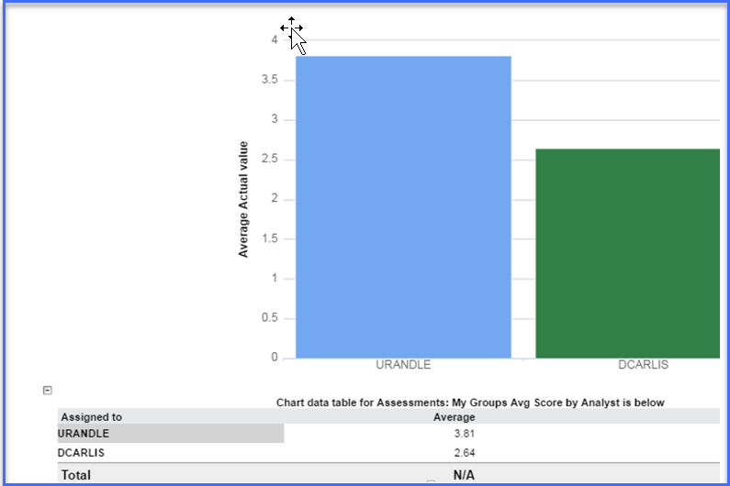
Analyst Scorecard

Slide 19
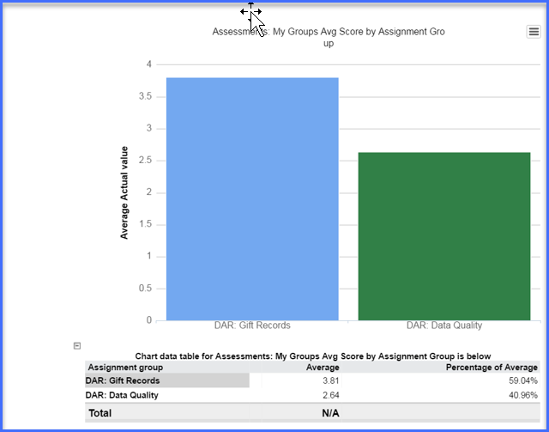
Assignment Group Scorecard

Slide 20
Scorecards by Questions
Assessments: My Groups Avg Score by Analyst per Question
Assessments: My Groups Avg Score by Assignment Group per Question
Assessments: My Groups Avg Status Updates Received Score
Assessments: My Groups Avg Technical Skill or Knowledge Score
Assessments: My Groups Avg Courtesy of Support Staff Score
Assessments: My Groups Avg Overall Resolution Score
Assessments: My Groups Avg Overall Service Experience Score
Assessments: My Groups Avg Promptness of Initial Response Score
Assessments: My Groups Avg Timeliness of Completion Score
Assessments: My Groups Customer Comments

Slide 21
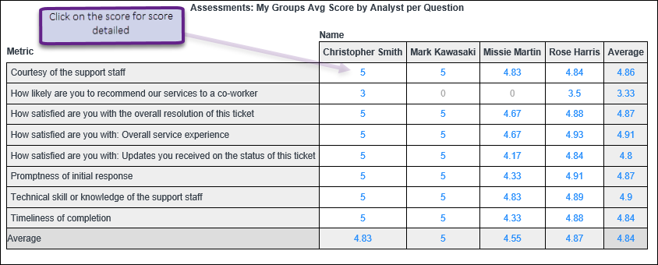
Analyst Scorecard by Question

Slide 22
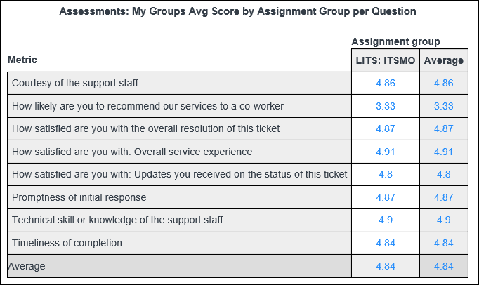
Assignment Group Scorecard per Question
Notes:
This report shows all the Likert scale questions and responses for each analyst in your group(s) for both “Record Type “ Incidents and Requests resolved or closed last month and compiles the data into a scores. It is labeled: Customer Satisfaction - Question by Analyst - Closed or Resolved Last Month - My Groups. As you can see from this one report you can get an overall analyst score (column averages);

Slide 23
Scorecards by Configuration Item (CI)
Assessments: My Groups Avg Score by CI per Question
Assessments: My Groups Avg Score by Analyst per CI
Assessments: My Groups Avg Score by Assignment Group per CI
Assessments: My Groups Avg Score by CI

Slide 24
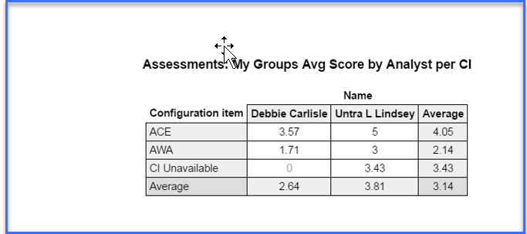
Analyst Scorecard by CI

Slide 25
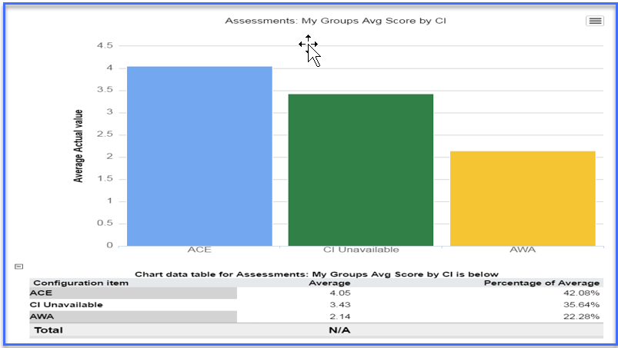
Assignment Group Scorecard by CI
Notes:
This report shows all the Likert scale questions and responses for each analyst in your group(s) for both “Record Type “ Incidents and Requests resolved or closed last month and compiles the data into a scores. It is labeled: Customer Satisfaction - Question by Analyst - Closed or Resolved Last Month - My Groups. As you can see from this one report you can get an overall analyst score (column averages);

Slide 26
A few More Reports
Assessments: All Assessment Answers (Raw Data)
Assessments: Individual Ticket Assessment Results

Slide 27
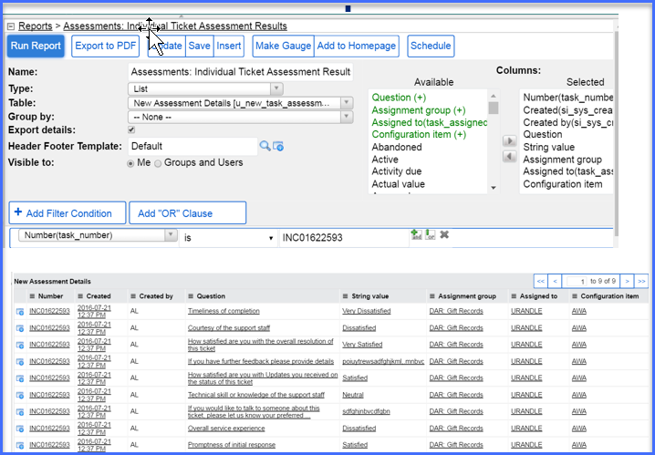
Individual Ticket Report

Slide 28
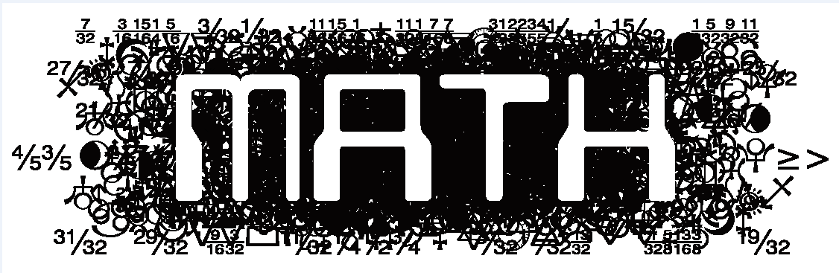
Scorecard Averages

Slide 29
Influencing Factors
Scorecards will average the rating on the scored questions
Reports with assessment scoring averages are based on individual questions
5 answer has a rating value ranging from (1 to 5) (Very Poor=1 and Excellent=5) 1 answer has a rating value ranging from (1 to 5 ) (Definitely would not recommend =1 and Would definitely recommend=5)
All of the questions are optional

Slide 30
Scorecard 101
If there are two questions scored on two surveys for an Analyst
The analyst score a (3) on both surveys
What is this Analyst Average?

Slide 31
Scorecard 101
If there are two questions scored on two surveys for an Analyst
The analyst score a (3) on both surveys
What is this Analyst Average?
The average is the scores of 3+3=6 divided by 2 (the number of questions answered) = Average Score of 3.0

Slide 32
Assignment Group Manager Responsibility
  Ensure ServiceNow Negative Feedback Notifications are not blocked (email rules & folders)
  Negative Response Procedures
  Treat Feedback as a continuing Incident
  Advise the user of the 5 - Day grace period to reopen a ticket
  If the Incident is closed before you are able to resolve the negative feedback, email sent to closed tickets will update the Incident activity log
  Follow-up on errant Assessments (KB05592)
  Do document customer resolution in the ticket
  DO NOT document personnel corrective steps in ticket
  You now have the option to set customer satisfaction goals for your team supported by your new Scorecard capability

Slide 33
Best Practice to Avoid Negative Feedback
Review the Assignment Group Managers roles and responsibilities
Use ServiceNow Management Dashboards view your groups Operational, Performance, and Volume reports
Use Quick message templates for staff to communicate consistent customer messaging from the ticket

Slide 34
Courtesy of support staff | Consider a Free or low cost customer Service class Emory Learning Services Linkedin Learning
Technical skill or knowledge of the support staff | Consider creating a Technical Training guide
Promptness of initial response | Review your Response SLA with Staff or Customer

Slide 35
Timeliness of completion | Review your Resolution SLA with Staff or Customer Be sure your staff understands how the pending code impacts the SLA clock
How satisfied are you with: Updates you received on the status of this ticket | At Emory we encourage faculty, staff and students to use the Service Portal for self-service. It is best practice to ensure your staff post frequent public notes to their tickets at least once per week, more often on high impact tickets and teach your customer to use the portal to find recent their ticket updates.

Slide 36
Managing Assessments
Use the ServiceNow Delegate function if you need others to manage negative feedback.
To remove an errant survey submission, we require a confirmation from the customer. Use the Errant Negative Assessment template to request the documentation from your customer.
Ensure staff is aware they may receive survey feedback. Share the assessment reporting with your staff.
  ServiceNow Assessment (Survey) Instructions including Reporting
The survey guidelines and terms of use are embedded in the Survey invitation. Understand the options available to you.
  ServiceNow Assessment (Survey) Privacy Guideline‏ and Terms of Use
Ensure your customers know How to Complete a ServiceNow Survey (Assessment)

Slide 37
Contact rdharr4@emory.edu you need assistance to reconcile negative assessment across multiple support groups.

